Slide 1
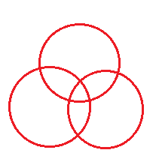
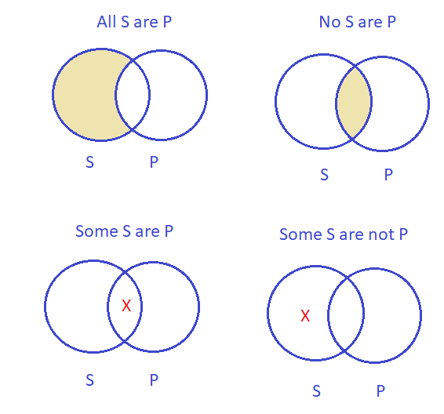
Review: Categorical Logic
Four categorical propositions
Venn diagram
Rules for validity check
- Draw 2 circles at bottom, one on top
- Label 2 classes in conclusion at bottom
- Perform only two actions for 2 premises
- Check validity:
+ Action for conclusion already done: Valid
Stylistic variants
+ Action for conclusion not yet done: Invalid
All S are P:
words of extremes, positive forms
No S are P:
words of extremes, negative forms
Some S are P:
more than one → nearly all, positive forms
Some S are not P:
more than one → nearly all, negative forms

Slide 2
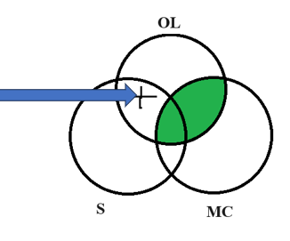
Question 1
If every student studies on the main campus, he/she is not taking the online lesson now.
A number of students are taking the online lesson now.
So, not all students study on the main campus.
Standardized argument:
No online lesson takers (OL) are main campus studiers (MC).
Some students (S) are online lesson takers (OL).
So, some students (S) are not main campus studiers (MC).
Venn diagram
Symbolic argument:
No OL are MC
Some S are OL
So, some S are not MC
Conclusion: Valid
Notes:
Nguyen Minh An - BEBEIU22185
Vu Cao Bang - BEBEIU22014
Tran Thi Ngoc Diep - BEBEIU22183
Nguyen Do Quoc Hai - BEBEIU22032
Ngo Minh Khoi - BEBEIU22063
Nguyen Quoc Trung Nhan - BEBEIU22184
Vo Duc Trong - BEBEIU22155
Lam Hoang Xuan Yen - BEBEIU22272

Slide 3
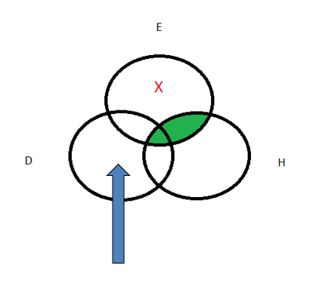
Question 2
A few students who want easy quizzes do not want to think deeply.
Not a student who wants easy quizzes can score high.
So, each student who wants to think deeply can get high scores.
Standardized argument:
Some easy quiz wishers (E) are not deep thinking students (D).
No easy quiz wishers (E) are high-scoring students (H).
So, all deep thinking students (D) are high-scoring students (H).
Venn diagram:
Symbolic argument:
Some E are not D
No E are H
So, all D are H
Conclusion: Invalid
Notes:
Minh An - BEBEIU22185
Vu Cao Bang - BEBEIU22014
Tran Thi Ngoc Diep - BEBEIU22183
Nguyen Do Quoc Hai - BEBEIU22032
Ngo Minh Khoi - BEBEIU22063
Nguyen Quoc Trung Nhan - BEBEIU22184
Vo Duc Trong - BEBEIU22155
Lam Hoang Xuan Yen - BEBEIU22272
e

Slide 4
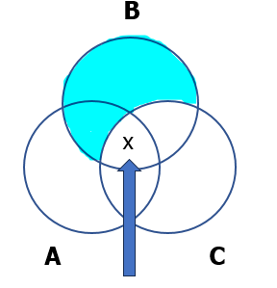
Question 3
Most clubs you attend can build your soft skills. If you build your soft skills now, you will definitely become efficient professionals later. So many club attendants can be more effective at work later.
Venn diagram
Standardized argument:
Some club attendants (A) are soft skills builders (B).
All soft skills builders (B) are future efficient professionals (C).
So, some club attendants (A) are future efficient professionals (C).
Symbolic argument:
Some A are B
All B are C
So, some A are C
Conclusion: Valid
Notes:
Nguyen Minh An - BEBEIU22185
Vu Cao Bang - BEBEIU22014
Tran Thi Ngoc Diep - BEBEIU22183
Nguyen Do Quoc Hai - BEBEIU22032
Ngo Minh Khoi - BEBEIU22063
Nguyen Quoc Trung Nhan - BEBEIU22184
Vo Duc Trong - BEBEIU22155
Lam Hoang Xuan Yen - BEBEIU22272

Slide 5
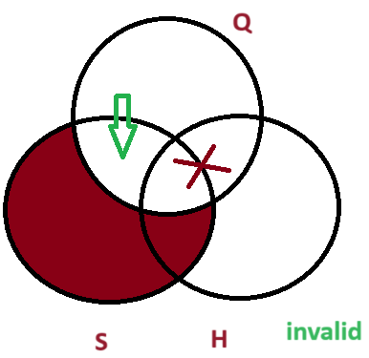
Question 4 - Fixed
Create a categorical syllogism: 1) with both premises in the stylistic forms and the conclusion in the standard form, and 2) about the topic of Quiz 1 questions/your result. Then check its validity using Venn diagram.
Stylistic argument:
Every student did Quiz 1 but only some could reach high scores, so not many students have high scores.
Standardized argument:
All students ( S) are Quiz 1 takers ( Q)
Some Quiz 1 takers ( Q) are high scorers (H)
So some students (S) are not high scorers (H)
Symbolic argument:
All S are Q
Some Q are H
So, some S are not H
Notes:
Lê Minh Thư - IEIEIU22073
Nguyễn Đoan Trang - IEIEIU22071
Nguyễn Ngọc Bảo Hân - FAFBIU22245
Đỗ Minh Anh - BABAIU22541
Lê Thanh Duy - IEIEIU22082
Vũ Trần Nhật Nam - MAMAIU22138

Slide 6
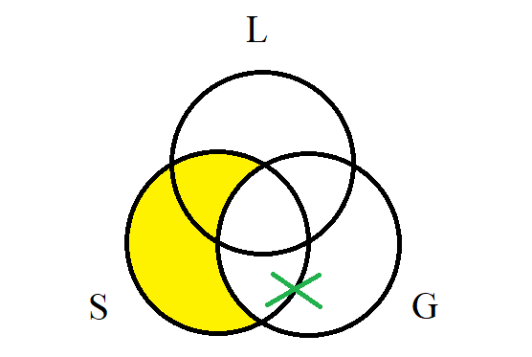
Question 5
Create a categorical syllogism 1) with the premises containing All & Some and the conclusion containing No, 2) all three statements must be the stylistic variants, and 3) about the topic of gains/losses of a semester with more than 20 credits. Then standardize it and check its validity using Venn diagram.
Stylistic argument:
All semesters with more than 20 credits result in significant gains.
Q S C P
Some gains are not losses.
Q S C P
Therefore, no semester with more than 20 credits results in a loss.
Q S C P
Standardized argument:
All semesters with more than 20 credits (S) are gains (G).
Some gains (G) are not losses (L).
Therefore, no semesters with more than 20 credits (S) are losses (L).
Venn diagram
Symbolic argument:
All S are G
Some G are not L
Therefore, no S are L
Conclusion: This is an invalid argument.
Notes:
Phan Tấn Phong - BAFNIU21535
Trương Thị Vân Anh - ENENIU22143
Nguyễn Ngọc Anh Thư - ENENIU22154
Nguyễn Tấn Dũng - ITITIU21185
Lê Nguyễn Gia Anh - ENENIU22140
Nguyễn Lê Ngọc Minh - ENENWE22344
Lê Anh Thy - ENENWE21409
Dương Minh Nguyệt - ENENIU22101

Slide 7
Propositional Logic
Chapter 10
A simple language useful for showing key ideas and definitions
Notes:
In Chapter 9, we learn Venn diagram as a tool to test the validity of categorical logic. Categorical logic is a great way to analyze arguments, but only certain kinds of arguments with two premises from four kinds of categorical statements. This means that categorical logic excludes certain common arguments that are not well-formed arguments in categorical patterns.
For example: I will either go out for dinner tonight or go out for breakfast tomorrow.
I won’t go out for dinner tonight.
So I will go out for breakfast tomorrow.
For this argument, Venn diagram fails to test its validity.
In Chapter 10, we learn one more tool to test the validity of these arguments, which is propositional logic. Remember that both categorical arguments and propositional arguments are deductive reasoning.
Propositional logic, also known as sentential logic and statement logic, is the branch of logic that studies ways of joining and/or modifying entire propositions, statements or sentences to form more complicated propositions, statements or sentences. In our lesson, we’ll learn how to use a tool which is called the Truth table to test the validity of our arguments made up of some propositions.

Slide 8
Review: Proposition
The term proposition is sometimes used synonymously with statement:
- As a simple unit, it expresses a complete idea which can be evaluated as true or false.
Example: HCM International University is a public university.
- As a more complex unit, it combines several statements which can be evaluated as true or false.
Example: HCM International University is a public university and RMIT is a public university.
Notes:
The fundamental logical unit in propositional logic is a statement, or proposition. Simple propositions are statements that contain no other statement as a part. Complex propositions contain more than one simple statement.

Slide 9
Contents
Four types of propositions
1. Conjunction
2. Negation
3. Disjunction
4. Conditional statements
Notes:
In your textbook, there are four types in propositions:
Conjunctions: They are “and” sentences. They put two statements, called conjuncts, together. In Vietnamese, “conjunction” means “phép hội”
Ex: Class learning is interactive and online learning is convenient.
In logic, conjunctions include “but”.
2. Negations: They are “not” statements. They assert that something is not the case. In Vietnamese, “negation” means “phép phủ định”
Ex: Online learning is not convenient.
3. Disjunctions: They are “or” statements. They claim one choice or another, or both. In Vietnamese, “disjunction” means “phép tuyển”
Ex: We can learn online now or we can do make-up class learning.
4. Conditional statements: The conditional is a common type of sentence. It claims that something is true, if something else is also true. In Vietnamese, “conditional statement” means “phép kéo theo”
Ex: If we learn online now, we will not have make-up classes later.

Slide 10
Symbolic connectives
→
Statements are combined by connectives:
&/∧ and Conjunction
˜/¬ not Negation
∨ or Disjunction
→ if Implication/conditional
Notes:
There are universal symbols to indicate the four propositions. We’ll use the four following symbols to suit your textbook:
&: and (conjunction)
˜ : not (negation)
∨: or (disjunction)
→: if (conditional)

Slide 11
Variables and examples of PL statements
Variables: Propositional symbols assigned to different parts of the argument.
P & Q P & ~Q Q → P P v Q (P& Q) → R
It is hot and it is humid. It is hot but it’s not humid. If it is humid, then it is hot. It is hot or it is humid. If it is hot and humid, then it is raining.
Example:
P: It is hot.
Q: It is humid.
R: It is raining.
Notes:
Propositional logic is language, so it has a syntax. The syntax of this language includes the basic symbols plus rules for putting together proper statements.
We use letters to represent simple statements, and these letters are called variables. The term ‘variable’ means that you can change these representative letters the way you want: A, B, C… or P, Q, R… or X, Y Z….
Later on, we will use a letter from the proposition so that you can figure out what it represents more easily.
For example: ‘It is hot.’
You can label this proposition with a variable A or P, or more suggestively, H (meaning ‘hot’).

Slide 12
1. CONJUNCTION (&/and)
A statement can be regarded as true or false (truth values).
A simple statement: a simple sentence regarded as true or false.
Example: IU is a university.
A compound statement: two or more statements regarded as true or false.
Example: Summer is hot and winter is cold.
It is hot and humid.

Slide 13
1. CONJUNCTION – Truth table
Summer is hot and winter is cold.
p q
p q p&q
T T T
T F F
F T F F F F
Note: ‘and’ can be replaced with but, yet, while, whereas, although, though, however
Notes:
Let’s first consider the compound proposition: Summer is hot and winter is cold.
There are two variables in this proposition: p (representing ‘summer is hot’) and q (representing ‘winter is cold’).
There are 4 combinations of these two variables:
p is true (T) and q is true (T)
p is true (T) and q is true (F)
p is true (F) and q is true (T)
p is false (F) and q is false (F)
Column p & q follow the rules:
- A conjunction is true only when all of its variables are true. Or: p & q are true only when p is true and q is true. (case 1)
- A conjunction is false when at least one variable is false, or all variables are false: either p or q is false or both of them are false. (cases 2, 3, 4)
In propositional logic ‘and’ can be replaced with but, yet, while, whereas, although, though, however…. This means the statements which support or contrast each other are also conjuncts.

Slide 14
Truth table for two variables
Truth table for three variables
p | q
T | T
T | F
F | T
F | F
A | B | C
T | T | T
T | T | F
T | F | T
T | F | F
F | T | T
F | T | F
F | F | T
F | F | F
Notes:
There is a trick for you to remember easily: With two variables, we set up a truth table (4 lines) like this:
- Column 1 includes two blocks of two true values and two false values
T
T
F
F
Column 2 (to the right), we alternate the values by a half:
T
F
T
F
When there are three variables set the default columns (8 lines) like this:
- Column 1 includes two blocks of four true values and four false values
T
T
T
T
F
F
F
F
Column 2 (to the right), we alternate the values by a half:
T
T
F
F
T
T
F
F
Column 3 (to the right), we continue to alternate the values by a half:
T
F
T
F
T
F
T
F

Slide 15
EXERCISE
Without knowing what they represent, assume that:
- p, q, r are true
- w, x, y are false
Determine whether each of the following is true or false.
1. p & q 2. p & w
3. x & y 4. r & q
5. r & y 6. y & w
7. x & w 8. q & r
9. p & y 10. r & p
Notes:
Answers:
T
F
F
T
F
F
F
T
F
T

Slide 16
1. Conjunction and validity
Rule of validity:
- In a valid argument, it is impossible for all the premises to be true and the conclusion false.
- If any instance of all true premises is followed by a false conclusion - an F under the conclusion column - the argument is invalid.
p q p&q
T T T
T F F
F T F F F F
Notes:
Do not forget that we can only test the validity of an argument, not a proposition.
The truth table above is set for a proposition, so we can only list all the truth values of the two variables and their conjunctions.

Slide 17
1. CONJUNCTION – Validity
The sky is blue. (p)
The grass is green. (q)
Therefore, the sky is blue and the grass is green.
p q p&q
T T T
T F F
F T F F F F
Notes:
This is an argument (with a conclusion), so now we can test its validity.
Go to the next slide to see how we do it.

Slide 18
1. CONJUNCTION – Validity
The sky is blue (p).
The grass is green (q).
Therefore, the sky is blue and the grass is green.
p* q* p&q C
T T T
T F F
F T F F F F
* The argument is valid.
Symbolic argument:
p
q____
So, p & q
Notes:
In this truth table, we do this:
Put an asterisk (*) next to a variable to mark it as a premise.
Put C next to a conclusion to make it recognizable.
3. We only consider the cases when all the premises are true. In the above example, we only consider line 1 (with all true values of all premises) and ignore lines 2,3,4 (with false values of either premise)
To test validity, we check each line of the truth table to see:
If all the premises in this line are true and the conclusion is true, this line is temporarily valid, then we move on to another line containing all the truth values of the premises.
If we move to the last line and see all the conclusion values are true, this argument is VALID.
If we have any line (top down) with all true premise values and one false conclusion value, we stop and conclude that this argument is INVALID.
In the above argument, there is only one case to consider in line 1: both premises are true. Then we check the conclusion: it is also true. So we stop and conclude: this argument is VALID.

Slide 19
1. CONJUNCTION – Validity
The grass is green (p).
Therefore, the grass is green (p) and the sky is blue (q).
p* q p&q C
T T T
T F F
F T F F F F
Symbolic argument:
p
p & q
* The argument is invalid.
Notes:
Now we have another argument and we set up a truth table for it.
There is one premise with one variable (p).
The conclusion has two variables p & q
There are two cases we need to check: line 1 and line 2, because these two lines contain the true premise.
In line 1, the premise is true and the conclusion is also true: the argument is temporarily valid. Then we move on:
In line 2, the premise is true and the conclusion is false: the argument is false. Then we stop and make the final conclusion.
This argument is INVALID (with at least one false conclusion value)

Slide 20
1. CONJUNCTION – Validity
Tom is short and fat.
Therefore, Tom is short.
pC q p&q*
T T T
T F F
F T F F F F
Symbolic argument:
p & q
p
Notes:
Now we have another argument and we set up a truth table for it.
This argument has two variables: Tom is short (p) and Tom is fat (p).
There is in one premise with a compound proposition: p & q*
The conclusion is variable p^{C}
There is one case we need to check: line 1 which contains the true premise.
We check the conclusion: it its also true.
This argument is VALID.

Slide 21
1. CONJUNCTION – Validity
Tom is short and fat.
Therefore, Tom is short.
p q p&q* pC
T T T T
T F F T
F T F F F F F F
Let’s repeat the p column in the right.
Symbolic argument:
p & q
p
The argument is valid.
Notes:
Now we have another argument and we set up a truth table for it.
This argument has two variables: Tom is short (p) and Tom is fat (p).
There is in one premise with a compound proposition: p & q*
The conclusion is variable p^{C}
There is one case we need to check: line 1 which contains the true premise.
We check the conclusion: it its also true.
This argument is VALID.

Slide 22
Exercise – Testing validity
- p&q
.
. . q

Slide 23
CONJUNCTION – Testing validity
- p&q
.
. . q
p q p&q* qC
T T T T
T F F F
F T F T F F F F
The argument is valid.

Slide 24
2. NEGATION
The use of not to deny a proposition.
Example:
- Tina is tall. (p)
- Tina is not tall. ( ˜p)

Slide 25
2. NEGATION
p q ˜p ˜q
T T F F
T F F T
F T T F
F F T T

Slide 26
NEGATION: Testing validity
Tina is not tall, but Sarah is tall. So, Tina is not tall.
Symbolic argument:
˜p & q
˜p
p q ˜p ˜p&q* ˜p C
T T F F F
T F F F F
F T T T T
F F T F T
The argument is valid.

Slide 27
2. NEGATION: Testing validity (2)
Frank does not drive a truck.
So, Frank does not drive a truck, and Vinny does not drive a van.
Symbolic argument:
˜p
.
˜p & ˜q
p q ˜p* ˜q ˜p& ˜qC
T T F F F
T F F T F
F T T F F
F F T T T
Invalid

Slide 28
3. DISJUNCTION
Two or more statements set apart, usually by the word or.
Example:
- Frank is angry or Hank is tired. (p v q) - For propositional logic, or has non-exclusive sense. This means the statement is true if either Frank is angry or Hank is tired.
p q p v q
T T T
T F T
F T T F F F

Slide 29
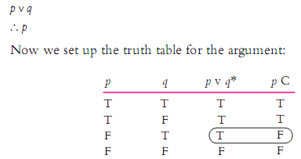
3. DISJUNCTION – truth table
Frank is angry or Hank is tired.
So, Frank is angry.
Symbolic form and the truth table:

Slide 30
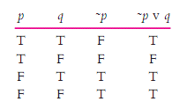
DISJUNCTION and NEGATION – truth table
Frank is not angry or Hank is tired.

Slide 31
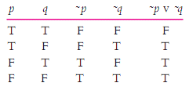
DISJUNCTION and NEGATION – truth table
Frank is not angry or Hank is not tired.

Slide 32
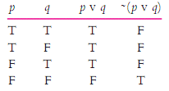
DISJUNCTION and NEGATION – truth table
It’s not the case that Frank is angry or Hank is tired.

Slide 33

CONJUNCTION, NEGATION & DISJUNCTION
It’s not the case that Frank is angry or Hank is tired.
So, Frank is not angry and Hank is not tired.
Symbolic argument:
Let’s set up the truth table:

Slide 34
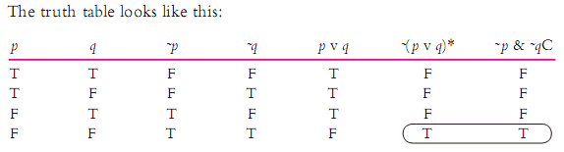
CONJUNCTION, NEGATION & DISJUNCTION
It’s not the case that Frank is angry or Hank is tired.
So, Frank is not angry and Hank is not tired.
Symbolic argument form:

Slide 35

CONJUNCTION, NEGATION & DISJUNCTION
Consider an argument with three variables that involves disjunction, negation, and conjunction:
Frank is angry or Hank is tired.
It’s not the case that Hank is tired and Larry is lonely.
So, Hank is tired.
Symbolic argument:

Slide 36

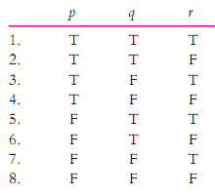
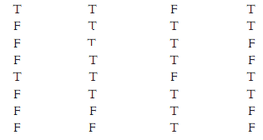
CONJUNCTION, NEGATION & DISJUNCTION
Frank is angry or Hank is tired.
It’s not the case that Hank is tired and Larry is lonely.
So, Hank is tired.
Invalid

Slide 37
4. CONDITIONAL STATEMENTS
If-then statements consisting of 2 parts: antecedent and consequent.
Example:
If it rained, then the ground is wet. (p → q) p q p → q
T T T
T F F
F T T F F T

Slide 38

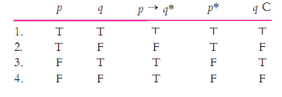
4. CONDITIONAL STATEMENTS
If it rained, then the ground is wet.
It rained.
So, the ground is wet.
Symbolic argument:
Truth table:
Valid

Slide 39
Summary of conjunction (p & q), negation ~(p&q), disjunction (p v q) and conditional statement (p→q)
p | q | ~p | ~q | p & q | ~(p&q) | p v q | p→ q
T | T | F | F | T | F | T | T
T | F | F | T | F | T | T | F
F | T | T | F | F | T | T | T
F | F | T | T | F | T | F | T
Notes:
Tricks to remember values of all propositions:
Conjunction: ONLY two T values: True
Negation: ~(compound proposition)
Disjunction: ONLY one T value: True
Conditional statement:
- same values for antecedent and consequent: True
- different values for antecedent and consequent: get the value of the consequent

Slide 40
Review
1. Propositions/arguments with 2 variables: a true table of 4 lines/rows
2. Propositions/arguments with 3 variables: a true table of 8 lines/rows
3. For propositions, only set up the truth table.
4. For arguments, check validity:
ONLY check the critical rows where all premise values are true, then look for the conclusion values
If all conclusion values are true: valid
If at least one conclusion value is false: invalid
*Note: Check the critical rows top down: True -> go on; False -> stop

Slide 41
PRACTICE
Convert each statement into symbolic form and generate its truth table.

Slide 42
1. The weather is beautiful outside but we cannot enjoy it.
Let:
Symbolic form:
W: the weather is beautiful outside
E: we can enjoy it
W & ~E
W | E | ~E | W & ~E
T | T | F | F
T | F | T | T
F | T | F | F
F | F | T | F

Slide 43
1. The weather is beautiful outside but we cannot enjoy it.
Let:
Symbolic form:
W: the weather is beautiful outside
E: we can enjoy it
W & ~E
W | E | ~E | W & ~E
T | T | F | F
T | F | T | T
F | T | F | F
F | F | T | F

Slide 44
2. If you want a good score but you don’t make efforts, your want is just wishful thinking.
Let:
G: you want a good score
E: you make efforts
W: your want is just wishful thinking
Symbolic form:
G & ˜E → W
G | E | W | ~E | G & ˜E | G & ˜E → W
T | T | T | F | F | T
T | T | F | F | F | T
T | F | T | T | T | T
T | F | F | T | T | F
F | T | T | F | F | T
F | T | F | F | F | T
F | F | T | T | F | T
F | F | F | T | F | T

Slide 45
2. If you want a good score but you don’t make efforts, your want is just wishful thinking.
Let:
G: you want a good score
E: you make efforts
W: your want is just wishful thinking
Symbolic form:
G & ˜E → W
G | E | W | ˜E | G & ˜E | G & ˜E → W
T | T | T | F | F | T
T | T | F | F | F | T
T | F | T | T | T | T
T | F | F | T | T | F
F | T | T | F | F | T
F | T | F | F | F | T
F | F | T | T | F | T
F | F | F | T | F | T

Slide 46
3. If we don’t revise the lesson contents, we will fail the midterm exam and our course scores will be low.
Let:
R: we revise the lesson contents
F: we will fail the midterm exam
S: our course scores will be low
Symbolic form:
˜R → F & S
R | F | S | ~R | F & S | ˜R → F & S
T | T | T | F | T | T
T | T | F | F | F | T
T | F | T | F | F | T
T | F | F | F | F | T
F | T | T | T | T | T
F | T | F | T | F | F
F | F | T | T | F | F
F | F | F | T | F | F

Slide 47
3. If we don’t revise the lesson contents, we will fail the midterm exam and our course scores will be low.
Let:
R: we revise the lesson contents
F: we will fail the midterm exam
S: our course scores will be low
Symbolic form:
˜R → F & S
R | F | S | ˜R | F & S | ˜R → F & S
T | T | T | F | T | T
T | T | F | F | F | T
T | F | T | F | F | T
T | F | F | F | F | T
F | T | T | T | T | T
F | T | F | T | F | F
F | F | T | T | F | F
F | F | F | T | F | F

Slide 48
Exercise 4: Test validity of the argument

Slide 49
4A. If the pandemic doesn’t end or we will study online again next semester, life is not fun for us at all. The pandemic does not end yet but we will not study online again next semester. So, life is fun for us.
Let:
E: the pandemic ends
S: we study online again next semester
F: life is fun for us
Symbolic argument:
˜E v S → ˜F
˜E & ˜S
∴ F
E | S | F | ~E | ~S | ~F | ~E vS | ˜E v S → ˜F* | ˜E & ˜S* | F^{c}
T | T | T | F | F | F | T | F | T | T
T | T | F | F | F | T | T | T | F | F
T | F | T | F | T | F | F | T | F | T
T | F | F | F | T | T | F | T | F | F
F | T | T | T | F | F | T | F | F | T
F | T | F | T | F | T | T | T | F | F
F | F | T | T | T | F | T | F | T | T
F | F | F | T | T | T | T | T | T | F
Invalid

Slide 50
4A. If the pandemic doesn’t end or we will study online again next semester, life is not fun for us at all. The pandemic does not end yet but we will not study online again next semester. So, life is fun for us.
Let:
E: the pandemic ends
S: we study online next semester
F: life is fun for us
Symbolic argument:
˜E v S → ˜F
˜E & ˜S
∴F
E | S | F | ˜E | ˜S | ˜F | ˜EvS | ˜EvS →˜F* | ˜E&˜S* | F^{C}
T | T | T | F | F | F | T | F | F | T
T | T | F | F | F | T | T | T | F | F
T | F | T | F | T | F | F | T | F | T
T | F | F | F | T | T | F | T | F | F
F | T | T | T | F | F | T | F | F | T
F | T | F | T | F | T | T | T | F | F
F | F | T | T | T | F | T | F | T | T
F | F | F | T | T | T | T | T | T | F
Invalid

Slide 51
4B. If our teacher checks attendance, absentees will be recorded and they will be prohibited from the exam. Our teacher doesn’t check attendance, so absentees will still take the exam.
Symbolic argument:
T → R & P
~T
∴~P
T = teacher checks attendance
R = absentees will be recorded
P = absentees will be prohibited
T | R | P | ~T* | ~P^{C} | R & P | T → R & P*
T | T | T | F | F | T | T
T | T | F | F | T | F | F
T | F | T | F | F | F | F
T | F | F | F | T | F | F
F | T | T | T | F | T | T
F | T | F | T | T | F | T
F | F | T | T | F | F | T
F | F | F | T | T | F | T
Invalid

Slide 52
4C. My girlfriend's phone at work is busy. My best friend's phone is also busy. If they are talking to each other, then both phones are busy. So, my girlfriend and my best friend are talking to each other over the phone.
Symbolic argument:
G
B
T → G & B
∴ T
G = My girlfriend’s phone at work is busy
B = My best friend’s phone at work is busy
T = My girlfriend & best friend talk to each other
G * | B* | T
T | T | T
T | T | F
T | F | T
T | F | F
F | T | T
F | T | F
F | F | T
F | F | F
In/valid

Slide 53
4C. My girlfriend's phone at work is busy. My best friend's phone is also busy. If they are talking to each other, then both phones are busy. So, my girlfriend and my best friend are talking to each other over the phone.
Symbolic argument:
G
B
T → G & B
∴ T
G = My girlfriend’s phone at work is busy
B = My best friend’s phone at work is busy
T = My girlfriend & best friend talk to each other
G * | B* | T | G & B | T → G & B* | T C
T | T | T | T | T | T
T | T | F | T | T | F
T | F | T | F | F | T
T | F | F | F | T | F
F | T | T | F | F | T
F | T | F | F | T | F
F | F | T | F | F | T
F | F | F | F | T | F
Invalid

Slide 54
4D. If Group A doesn’t do the assignment, Group B doesn’t do it, either. If these groups don’t do it, other groups will get the bonus points. So, if one of these groups doesn’t do the assignment, other groups will get the bonus points.
Symbolic argument:
~A → ~B
~A & ~B → G
∴ ~A v ~B → G
A = Group A does the assignment
B = Group B does the assignment
G = other groups get the bonus points
A | B | G | ~A | ~B | ~A → ~B* | ~A & ~B | ~ A & ~ B → G* | ~ A v ~ B | ~ A v ~ B → G^{C}
T | T | T | F | F | T | F | T | F | T
T | T | F | F | F | T | F | F | F | T
T | F | T | F | T | T | F | T | T | T
T | F | F | F | T | T | F | T | T | F
F | T | T | T | F | F | F | T | T | T
F | T | F | T | F | F | F | T | T | F
F | F | T | T | T | T | T | T | T | T
F | F | F | T | F | F | F | T | T | T
Invalid

Slide 55
ASSIGNMENT
Instructions:
The question “Who’s the thief?” is optional. Your weekly assignment includes 5 tasks that follow.
Delete all the lesson slides and keep only the Assignment slides to resubmit.
Link to submit:
https://forms.gle/XktoPWgKXMvjVaCR7

Slide 56
Names of your group

Slide 57
Who’s the thief?
OPTIONAL QUESTION
A theft was committed by one of the 9 people (called One to Nine) but the police don’t know who did it. Here are their answers when questioned:
One: Five is the thief.
Two: No, it’s not true!
Three: I did it.
Four: Either Three or Eight is the thief.
Five: Two said the wrong thing!
Six: Three is the thief.
Seven: No, Three is not the thief.
Eight: I’m not the thief, and Three is not, either.
Nine: What Eight says is correct, but Five is not the thief, either.
If only 3 out of 9 statements are true, who could be the thief?

Slide 58

Task 1: You will go to the Confessions page (C) if you take the elevator (E) to the second floor or push your friends (P). If you ride the elevator that way, you don’t go to the Confession page. So if you push your friends, you go to the Confessions page.
Let:
Symbolic argument:
Truth table
Add/Delete columns to suit your argument.
Invalid

Slide 59
Task 2: If a student does only one quiz before the midterm exam, his/her pre-mid quiz score will be halved. Some students do Quiz 1 and others do Quiz 2 before the midterm exam but they don’t do both quizzes. So their pre-mid quiz will not be halved if they do both quizzes.
Let:
Symbolic argument:
Truth table
Add/Delete columns to suit your argument.
Conclusion:

Slide 60
Task 3: If we don’t do group assignments carefully but we do textbook exercises well, we’ll be well prepared for the mid-term exam. It’s not the case that we do group assignments carefully but we don’t do all textbook exercises. So, we’ll get ready for the mid-term exam if we do them both.
Let
Symbolic argument
Truth table
Add/Delete columns to suit your argument.
Conclusion

Slide 61
Task 4: Create a propositional argument about the topic of one good/bad thing in student life with three variables, including at least a disjunction, a negation of a conjunction and a conditional statement, then turn it into the symbolic argument and evaluate its validity.
Your argument
Truth table
Symbolic argument
Add/Delete columns to suit your argument.
Conclusion

Slide 62
Task 5: Create a propositional argument a current trend with three variables including at least a conjunction, disjunction, a negation, and a conditional statement, then turn it into the symbolic argument and evaluate its validity using the truth table.
Your argument
Truth table
Let
Add/Delete columns to suit your argument.
Symbolic argument
Conclusion:

Slide 63
Thank you ☺

